Slide 1

ATHENA DECISION SYSTEMS
Harley Davis, CEO
harley@athenadecisions.com
+33 6 72 88 51 62
http://www.athenadecisions.com/

Slide 2


Athena Decision Systems
Athena Decision Systems offers expert AI consulting and implementation services around Hybrid AI.
We focus on a Hybrid AI approach, combining generative AI with business rules and machine learning to deliver great systems.
We help businesses to drive higher revenue, reduced risk, improved quality of service, and lower costs through better decision making.
Our core technical team is composed of leading industry experts in AI, decision management and process automation.

Slide 3

Why Hybrid AI?
GenAI has ears and a mouth, but no brain!
Unstructured data handling is a game changer.
But imprecision and hallucinations
are unacceptable risks in business applications.
Gen AI lacks structured logical reasoning.
Gen AI only decision-making is not reliable or trustworthy.
3
Notes:
Because Large Language Models behind Generative AI are statistical in nature, they are far less capable of structured logical reasoning or even just arithmetic capabilities

Slide 4
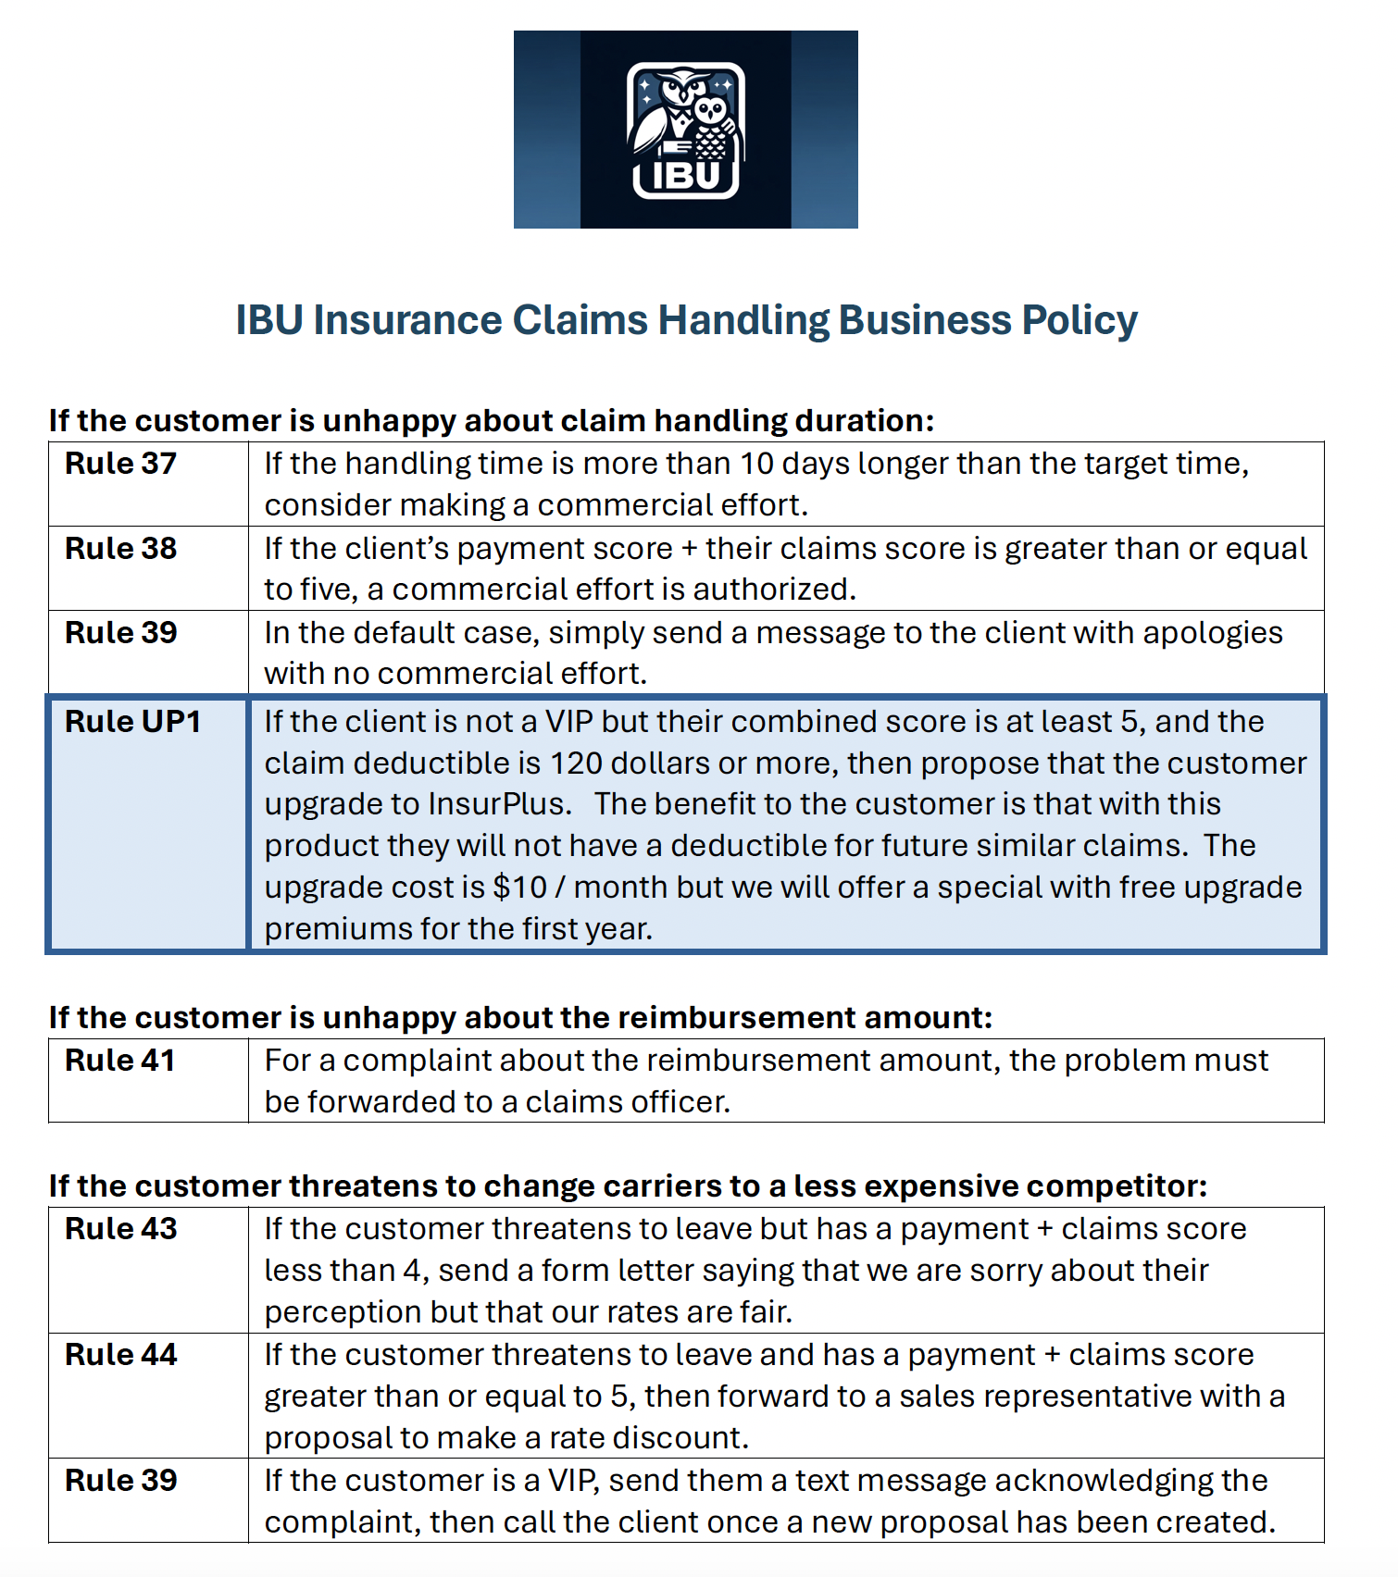
Example
Customer Service For Insurance Claims
Scenario:
IBU Insurance Company wants to support their customer service representatives with an interactive chatbot to help them respond to customer issues.
They need the chatbot to follow company policy in its responses – including proposing an upsell to a specific product in some circumstances.
“Customer Service is the proving ground for generative AI”
The CEO’s guide to generative AI: Customer service. IBM Institute for Business Value. August 2023. https://ibm.co/ ceo-generative-ai-customer-service
4
Notes:
The market has moved from excitement around generative AI to how to monetize on it. 45% of the market has already moved to pilots, and 10% has moved to production (source: Gartner).
When investigating and exploring, customers look for a wow factor, an aha moment, and that’s why very large 100B+ parameter general-purpose models shine. You can use them for a wide range of downstream tasks and they perform well OOTB.
However, as the market moves towards production and scale, customers soon realize the path to success is not that straight forward. The bigger the model, the larger GPU compute it would need to compute a response.
Our guiding principles:
👉 One model doesn’t fit all
👉 Bigger is not always better
👉 Specialized models can produce better results than larger, general-purpose models, and do so with lower infra requirements to achieve improved price-performance
Here’s what we’re focused on:
Expanding beyond English. We are expanding our English models to other languages, starting with Japanese and 5 European languages (English, Spanish, French, German, Portuguese) coming up in Q1. Early access in December, granite.8b.japanese (Feb 29 SaaS GA, March 27 on-prem GA), granite.13b.multi-lingual (March 14 SaaS GA, March 27 on-prem). We are also considering partnerships with 3rd party model providers like Elyza (Japanese), and Aleph Alpha (European languages)
Expanding beyond language. We are looking into establishing partnerships to bring multi-modality to the platform for visual QA. Stability.ai and Aleph Alpha Luminus model are examples.
Improving Performance. We just released granite.13b.v2 as a refresh to granite.v1 that is exposed to 2T token vs granite.13b.v1 that was only exposed to 1T tokens. Our granite.13b.V2 is priced 2.7X less at $0.0018/1000 tokens. We are expanding our granite collection to include a very large granite.50b model in Q2 as well as looking into 3rd party partners like Cohere.
Finally, it’s important to call out our indemnification terms:
BAU for IBM-developed models, offering the same standard terms and protection that we have been offering for HW and SW
IBM doesn’t require customers to indemnify IBM for the use of the models (IBM is one of the very few, if not the only one)
No cap on the IP liability and the financial responsibility IBM would take

Slide 5
Two AI-based approaches, which works best?
1
2
LLM + Documents
LLM + Business Rules
LLM analyzes customer messages to extract intent and context.
RAG is used for corporate documentation that describes complaint management rules.
LLM interprets policy to determine appropriate actions.
LLM generates responses for both agents and customers.
LLM analyzes customer messages to extract intent and context.
Business Rules outline complaint management policies.
Business Rules interpret policies and determine the right course of action.
LLM generates responses for both agents and customers.
Application code
Using Business Rules with an LLM grounds the decision-making.
5
Notes:
Decision automation improves overall efficiency, resulting in better experiences for everyone involved.
Business experts are empowered to define the destiny of their business logic and accelerate speed to market
Developers are freed to work on revenue-generating activities
Customers get more timely, personalized and accurate results

Slide 6
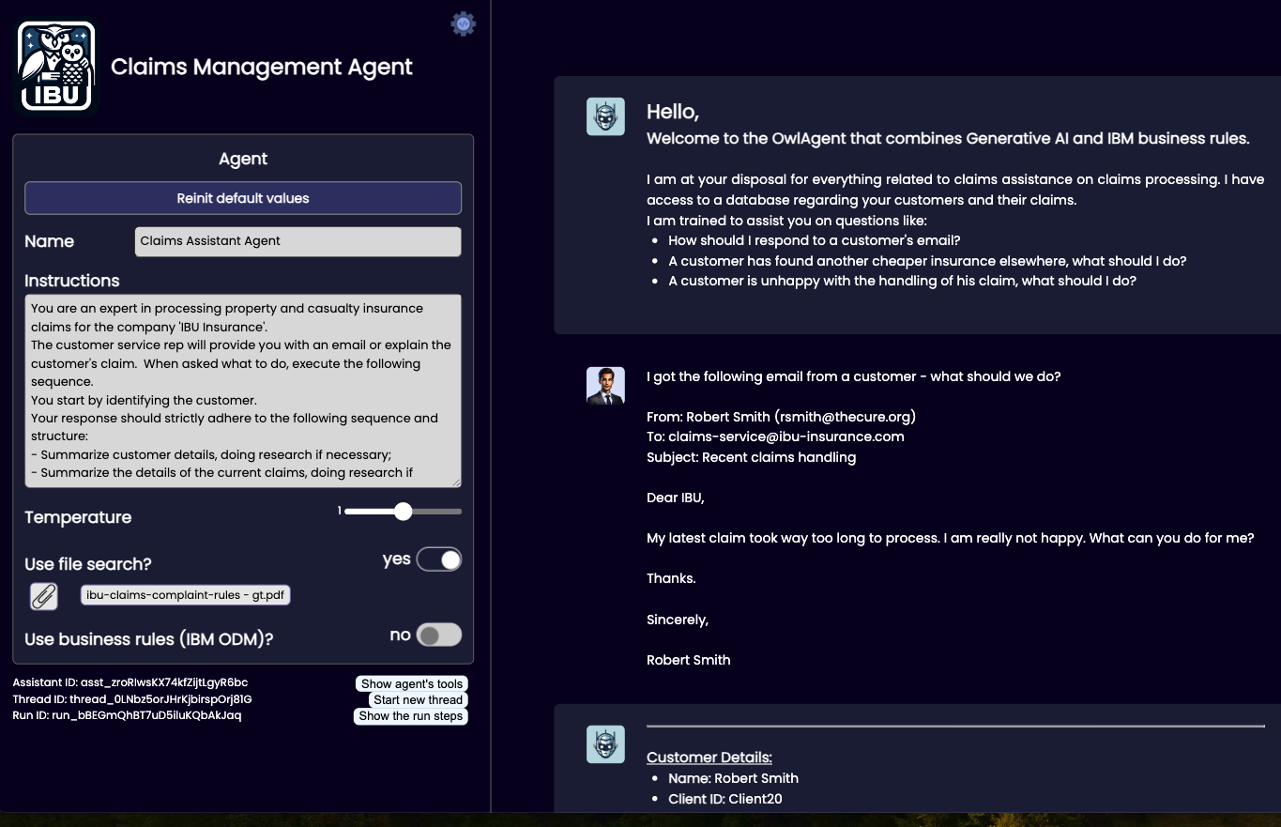
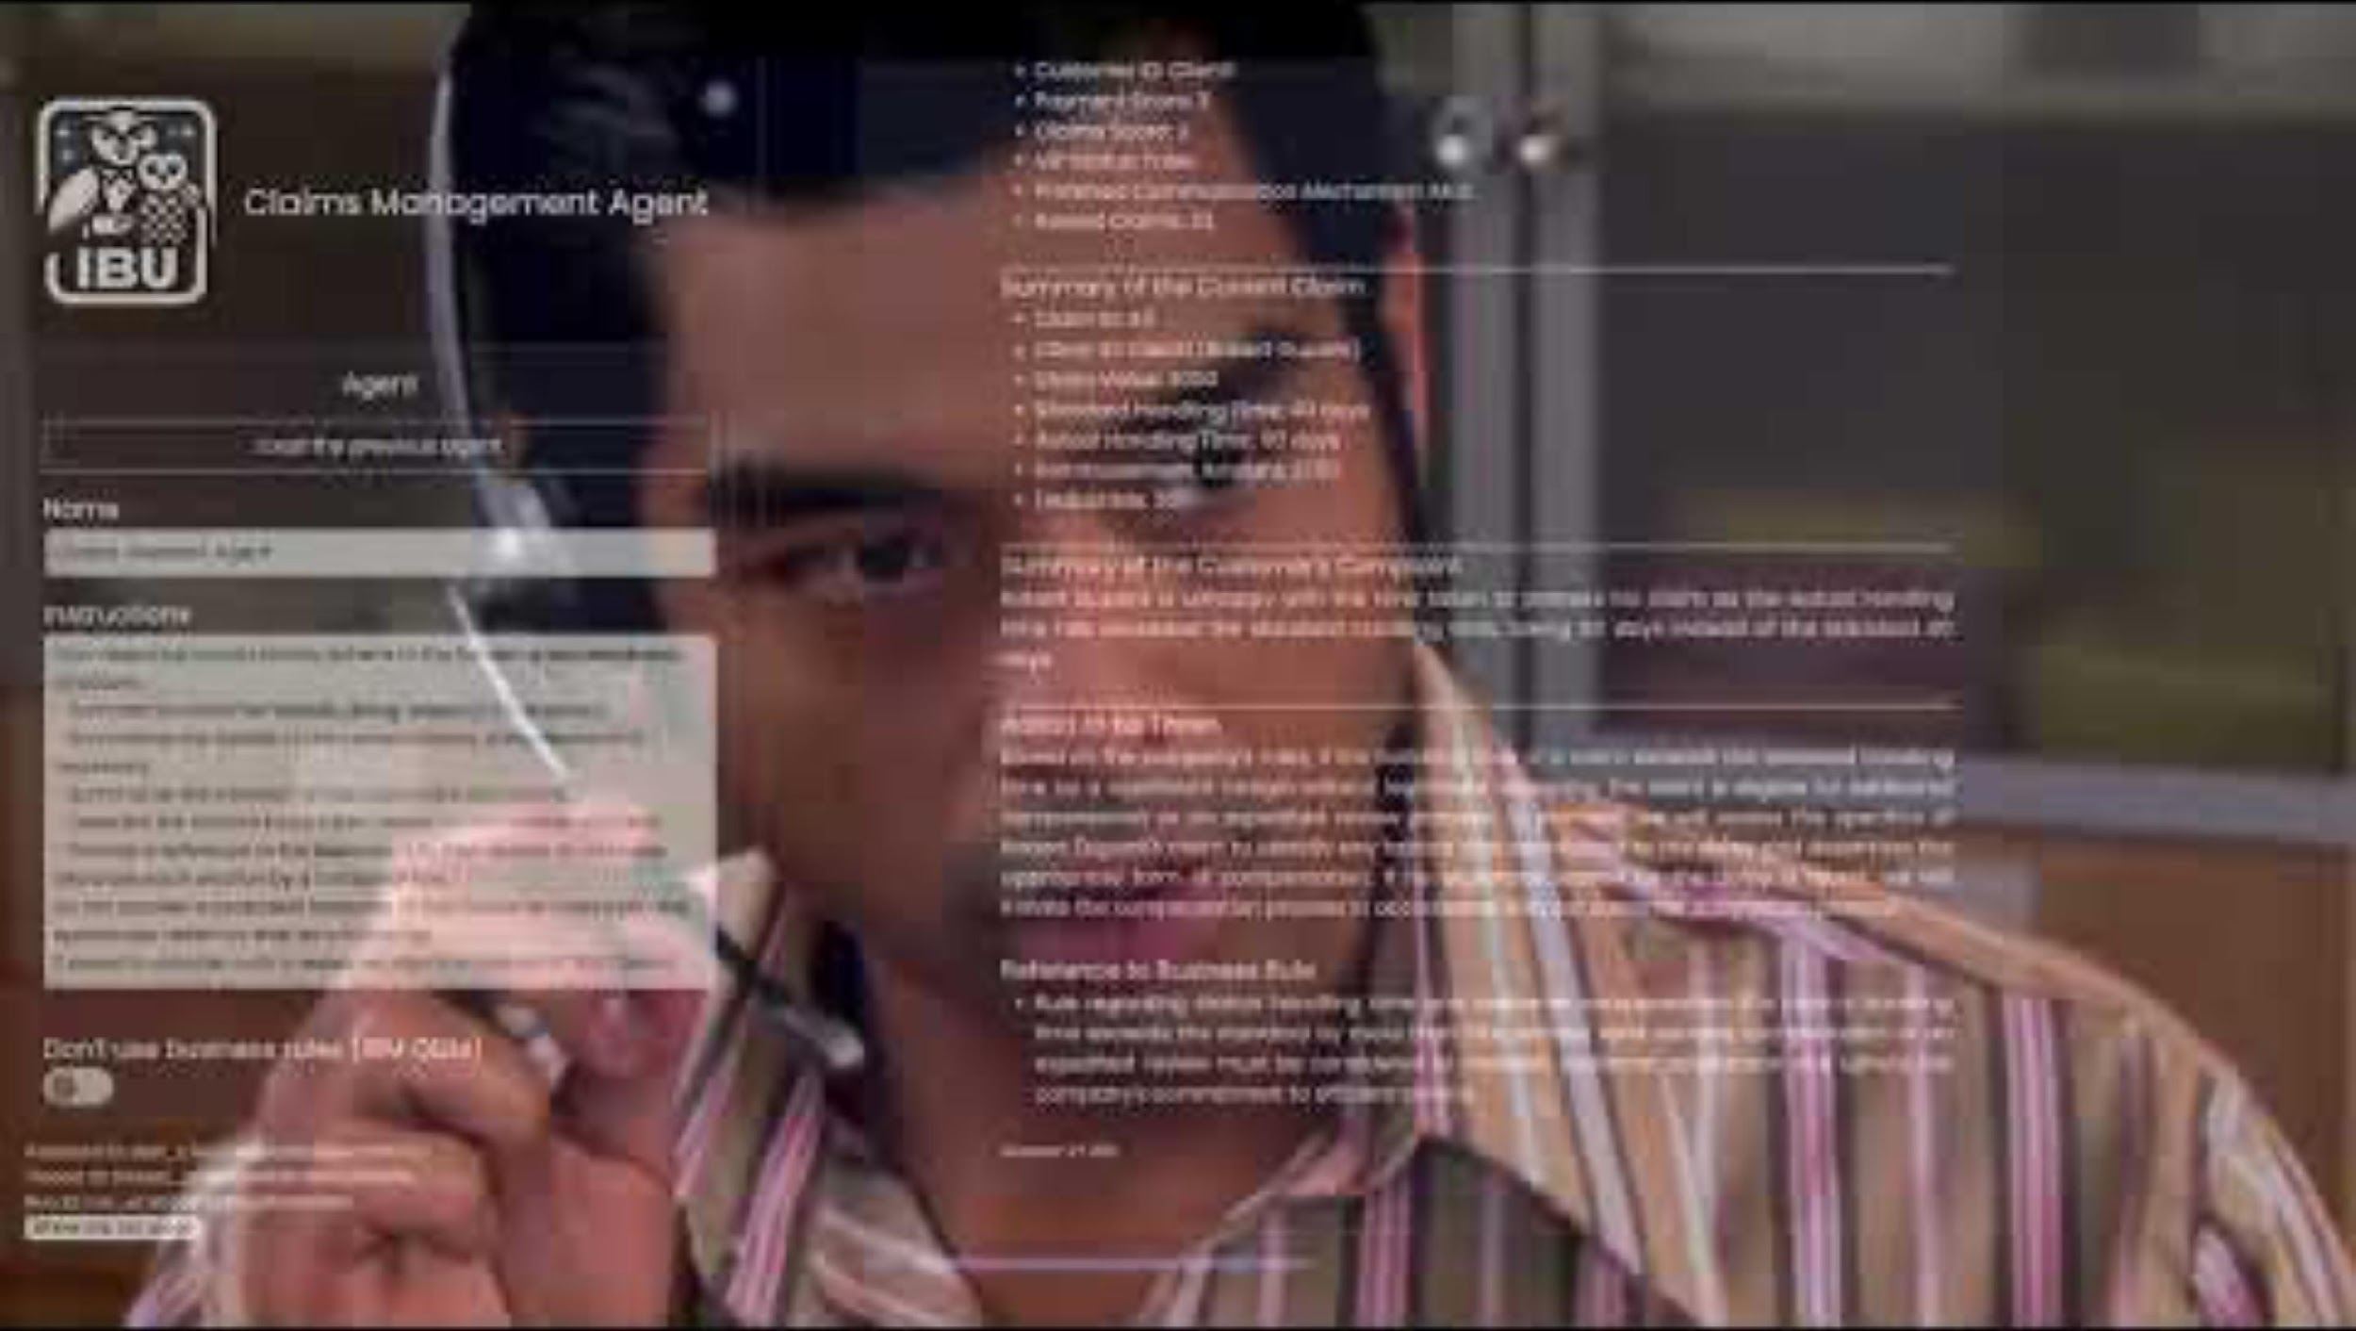
Example
Handling Claims Management
Let’s see it in action!
Video at:
https://youtu.be/fGEU_obHM5M
IBU Claims Management Agent Demo
6
Notes:
The market has moved from excitement around generative AI to how to monetize on it. 45% of the market has already moved to pilots, and 10% has moved to production (source: Gartner).
When investigating and exploring, customers look for a wow factor, an aha moment, and that’s why very large 100B+ parameter general-purpose models shine. You can use them for a wide range of downstream tasks and they perform well OOTB.
However, as the market moves towards production and scale, customers soon realize the path to success is not that straight forward. The bigger the model, the larger GPU compute it would need to compute a response.
Our guiding principles:
👉 One model doesn’t fit all
👉 Bigger is not always better
👉 Specialized models can produce better results than larger, general-purpose models, and do so with lower infra requirements to achieve improved price-performance
Here’s what we’re focused on:
Expanding beyond English. We are expanding our English models to other languages, starting with Japanese and 5 European languages (English, Spanish, French, German, Portuguese) coming up in Q1. Early access in December, granite.8b.japanese (Feb 29 SaaS GA, March 27 on-prem GA), granite.13b.multi-lingual (March 14 SaaS GA, March 27 on-prem). We are also considering partnerships with 3rd party model providers like Elyza (Japanese), and Aleph Alpha (European languages)
Expanding beyond language. We are looking into establishing partnerships to bring multi-modality to the platform for visual QA. Stability.ai and Aleph Alpha Luminus model are examples.
Improving Performance. We just released granite.13b.v2 as a refresh to granite.v1 that is exposed to 2T token vs granite.13b.v1 that was only exposed to 1T tokens. Our granite.13b.V2 is priced 2.7X less at $0.0018/1000 tokens. We are expanding our granite collection to include a very large granite.50b model in Q2 as well as looking into 3rd party partners like Cohere.
Finally, it’s important to call out our indemnification terms:
BAU for IBM-developed models, offering the same standard terms and protection that we have been offering for HW and SW
IBM doesn’t require customers to indemnify IBM for the use of the models (IBM is one of the very few, if not the only one)
No cap on the IP liability and the financial responsibility IBM would take

Slide 7

Use cases that empower the business
with Hybrid AI, we can build:
Insurance / Banking:
Next Best Action for customer support.
Formalize written policies into underwriting / claims handling rules.
Customer email interpretation and routing.
Semi-automatic interpretation of claims docs
Interactive AML / KYC / fraud detection support.
Industry:
Maintenance technician support.
Complex PO to BOM / product configuration.
Quality controls combining sensors with rules.
Public Sector:
Help public-facing agents with managing eligibility and inquiries.
Border Security – Analyze manifests, passenger data for alarms.
7

Slide 8
Hybrid AI with Business Rules Drives Value
Growth
Consistent customer response drives increased NPS scores.
Marketing upsell rules lead to new revenue opportunities.
Differentiated policy rules drives high-value customer retention and higher LTV.
Compliance
Business rules approach supports consistent compliance.
Explainability of decisions improves traceability and auditing.
Agility
Business rules can be updated quickly with no need to change or redeploy application.
Rules can support differentiated policies based on customer segmentation.
Operational Efficiency
Improved decision automation reduces human overhead.
Straight-through processing reduces both time to complete processes and human workload.
Automated decisions allow humans to focus on high-value and ambiguous cases.

Slide 9












Formalizing Policy As Business Rules
Athena Wisdom Forge
Explanation Links
Documents
Decision Models
Spreadsheets
Athena Wisdom Forge
Formalized decision spec draft
Business Rules
Databases
Business Analyst
Code
Models
Assist Business Analyst in managing and extracting business rules from documents, interviews, code, etc.
Interactive system keeping the human in the loop.
Leverage readable, formalized intermediate format.
Generate explanatory links to source material in business rules.
Experts
Test Cases
9

Slide 10


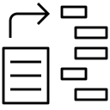
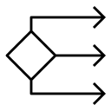

The Athena Solution
Business Analyst
End User
LLMs for knowledge capture
LLMs for interaction
Business Rules for precision & auditability
Athena Intelligent Agent
Athena Wisdom Forge
Athena Owl Agent (OSS)
https://bit.ly/athena-owl-framework
10

Slide 11
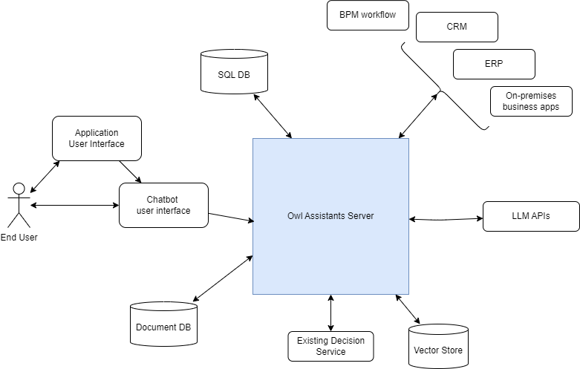
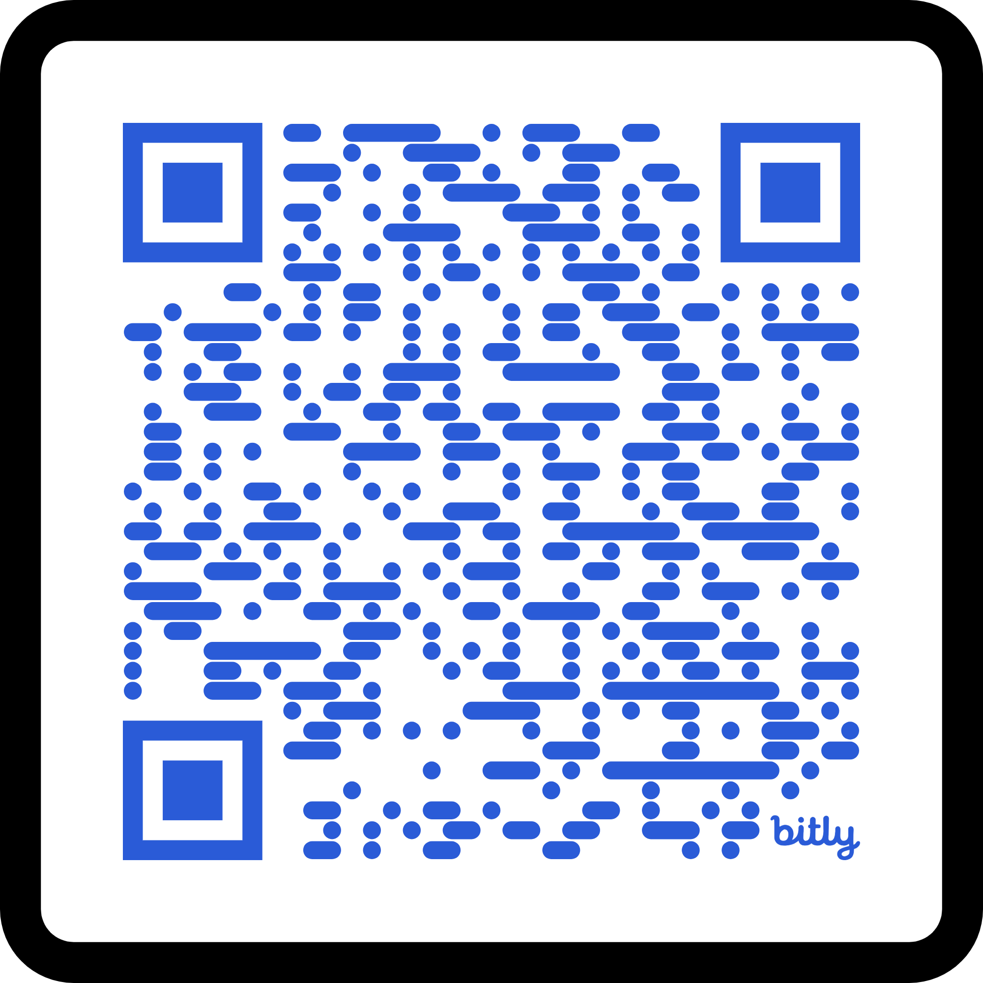
Athena Owl Agent Framework
Easily make an agent for your use case!
Agentic Architecture to integrate:
LLMs
Business Rule-based Decision Services
Databases
Vector Stores for RAG
3rd party API’s.
Declarative format for agent definitions.
Conversational interface with tool calling.
Supports multiple LLM platforms, business rule platforms, vector stores, databases.
Open-source framework, contributions welcome!
Athena Decision Services is here to support you.
https://bit.ly/athena-owl-framework

Slide 12

The World Is Changing Fast.
Athena Will Build Your Systems Now.
Decision Intelligence Consulting Services
Leverage the power of Generative AI.
Combine with the accuracy, speed, and explainability of business rules.
Integrate other automation technologies as needed.
Built for change: Rule governance services
Focused on IBM’s enterprise-ready AI and Automation technology.
Top Industry Experts
100% decision management experts.
Each with 20+ years experience building solutions.
Covering North America and Europe.
Key Partnerships:
IBM Business Partner
DecisionBrain Strategic Partner
NSI Business Partner
NexaQuanta Business Partner
12

Slide 13
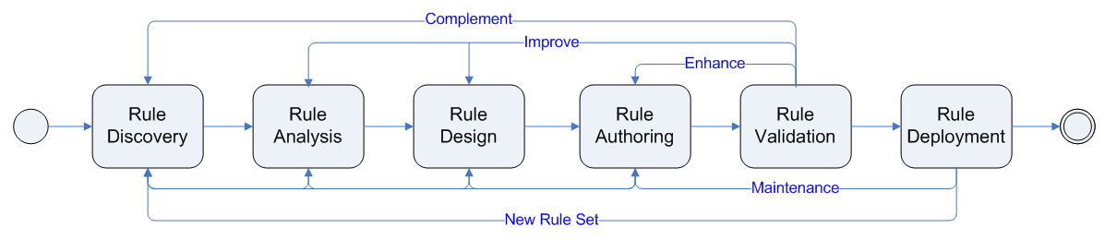
Athena Decision Service Project Methodology
Based on IBM’s Agile Business Rules Development Framework (ABRD):
https://ibm-cloud-architecture.github.io/refarch-dba/methodology/overview/
Created by an Athena principal, Jerome Boyer
Iterative development of decision services.
Integrate stakeholders: LOB, IT, development
Focus on business rule readability, maintainability, correctness, and explainability
Focus on quick results and rapid improvement

Slide 14
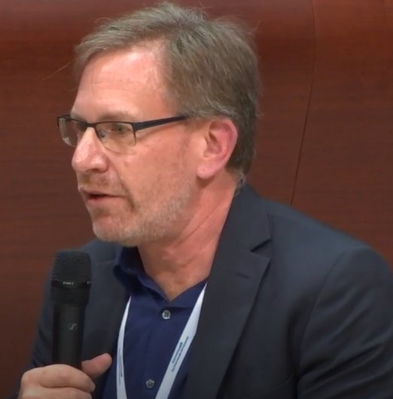




Harley Davis, Founder & CEO
Athena Decision Systems: Core Team
30+ AI software veteran in France and Silicon Valley
IBM France R&D Vice President, founded IBM AI Lab in Saclay.
Led sales, engineering and product management for IBM Decisions technology 12 years.
MIT AI SM / SB, Xerox PARC, ILOG sales / consulting / technology leadership
Jerome Boyer, Principal
Joël Milgram, Principal
30+ years in intelligent automation, cloud, and AI system development.
Distinguished Engineer at ILOG, IBM, AWS. Inventor of IBM intelligent automation project methodology.
Thought leader and author of multiple books and articles about intelligent decisioning, methodology, and cloud development.
30+ years in enterprise software internationally.
Senior technical adviser at Software AG, Lombardi, IBM, and Pegasystems
Deep experience in creating business solutions focused on Intelligent Automation using AI
Jean-Christophe Jardinier, Principal
Kallol Ghosh, Principal
30+ years in decisioning systems and digital transformation for enterprises.
Senior technical solution developer at ESA, ILOG, IBM, Provingly
Deep experience in software development, solution architecture, methodology, technical sales, and business development
25+ years of digital transformation and modernisation experience – led successful projects for banking, insurance, and public sector organisations.
Experienced solution architect, worked with leading software vendors like ILOG, IBM, Pega Systems and SI’s like Capgemini and NIIT Technologies
Expert in decision management and workflow solutions
14

Slide 15

Let’s take the next steps together:
Discovery workshop
Prototype
Pilot
Your system!
Thank you / Merci / Danke / Gracias!
http://www.athenadecisions.com/

Slide 16
Decision Management With Business Rules

Slide 17
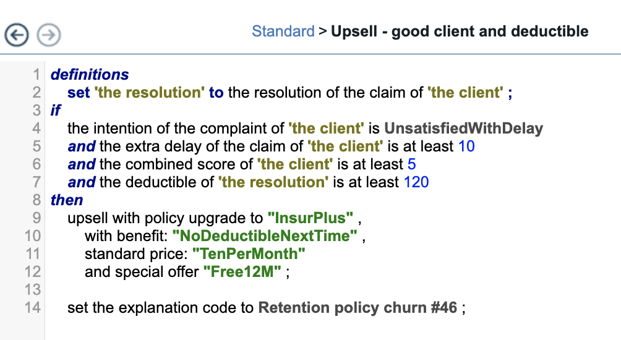
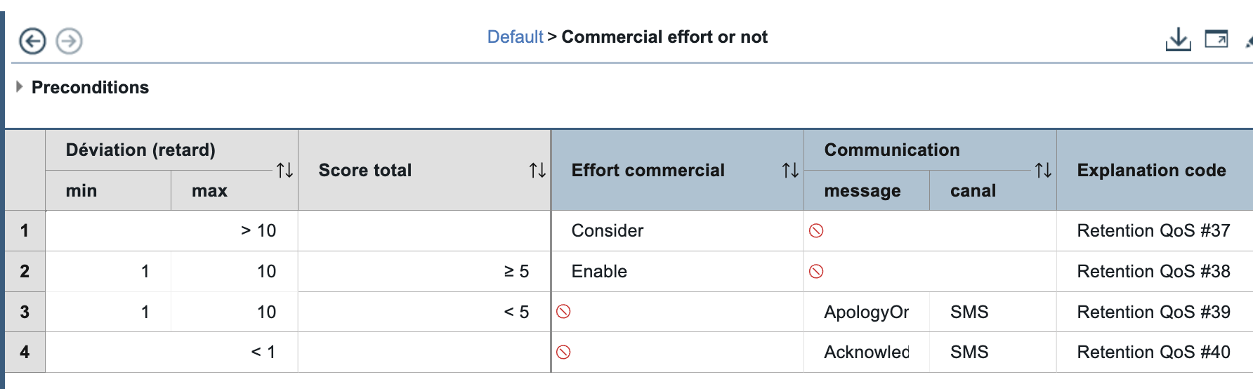
What is decision management?
Enabled by business rules
Decision management for agile updates without affecting other systems
Natural language rules to create and update policies using business-friendly language
Decision tables to capture many business rules with common conditions and actions in a single artifact
Consumed by other systems & applications to allow for straightforward, easy tracking
17
Notes:
So how does decision automation work?
Decision automation decouples business logic from the application. This allows it to be modified outside the application. Business users can build and updated decisions with language rules, models or tables.
You can combine analytical insights with business rules using machine learning to anticipate changing conditions
And decision history is surfaced, allowing for straightforward, easy tracking
With decision automation,
Updating decisions is faster. Decisions can be changed with zero down time, in seconds, not months
Application code requires less frequent updates, there is reduced risk of errors and faster time to market as
decision services are independent from every application

Slide 18
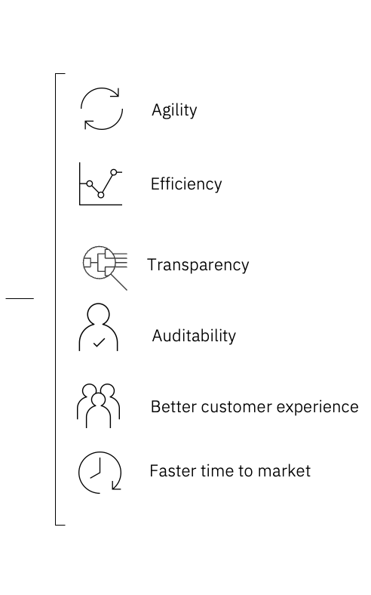
Why decision management?
Enhance LLMs with reliable & explainable decisions
Empowers business users to create and update policies
Allows quick updates when conditions change
Surfaces decision history for easy tracking & auditing
ML insights can be infused to improve decision accuracy
18
Notes:
Decision automation is the art and science of externalizing business decisions in the enterprise
With decision management systems, business logic is extracted from applications to ensure that business users can make changes quickly without engaging IT. When business demands change—for example, when policies change or compliance rules are modified—business users can quickly update decisions, providing the agility and speed needed in today’s fast-paced environment.
Allows quick updates when conditions change without impact to surrounding systems
Empowers business users to create and update policies with business-friendly language, models and tables
Combines analytical insights with business rules using machine learning to anticipate changing conditions
Surfaces decision history, to allow for straightforward, easy tracking
Benefits include:
Agility across the organization
More efficient processes and applications
Transparency and auditability for business decisions, and policies that underpin those decisions

Slide 19

IBM Decision management examples Major Credit Card Company
IBM Decision Management has been deployed by a major Credit Card Company, which processes an astonishing 1.2 billion payments daily, with a mere 50ms timeframe to approve or deny each transaction.
The company recognizes that even a single false positive or negative decision can have a significant business impact. To mitigate this risk, the credit card company has implemented
a hybrid decision-making approach, combining machine learning algorithms trained on historical fraud data with human-designed business rules informed by real-time reports.
As a result, the company is able to update its rules over 400 times daily, ensuring that its decisions remain accurate and effective in preventing fraud while minimizing false declines.
19
Notes:
In recent years, mobile phone operators in Turkey have been subject to much stricter regulations, especially around customer data and privacy. The new requirements impose penalties on operators who engage in customer relations operations with people who did not provide the relevant information when they signed their original contract.
Turkcell looked for a fast, accurate way to verify the data in the contracts. And with many contracts stored as low-quality photocopies, Turkcell needed a solution that could reliably extract the required information, even from poor-quality digital images.
Using IBM Datacap software, Turkcell checked the contract documents of customers whose CRM entries indicated that they had given permission to receive marketing communications. The company processed an average of 150,000 document files every day over the course of 13 months.
The results showed that nearly 5.9 million contracts had the right information; the remaining 1.9 million were passed on for manual verification, allowing Turkcell to update its CRM records to match customer preferences.
Case study: https://www.ibm.com/case-studies/turkcell/

Slide 20

IBM Decision management examples Large US P&C Insurance carrier
IBM Decision Management has been successfully implemented by a large US P&C Insurance carrier, which manages 82 million policies and has a network of 18,000 agents.
The company has leveraged AI in over 600 decision-making processes, combining business rules and machine learning to drive efficiency and accuracy. Specifically, AI has been applied to various critical functions, including claims approvals, policy underwriting, and agent commissioning, enabling the insurer to make more informed and timely decisions.
20
Notes:
In recent years, mobile phone operators in Turkey have been subject to much stricter regulations, especially around customer data and privacy. The new requirements impose penalties on operators who engage in customer relations operations with people who did not provide the relevant information when they signed their original contract.
Turkcell looked for a fast, accurate way to verify the data in the contracts. And with many contracts stored as low-quality photocopies, Turkcell needed a solution that could reliably extract the required information, even from poor-quality digital images.
Using IBM Datacap software, Turkcell checked the contract documents of customers whose CRM entries indicated that they had given permission to receive marketing communications. The company processed an average of 150,000 document files every day over the course of 13 months.
The results showed that nearly 5.9 million contracts had the right information; the remaining 1.9 million were passed on for manual verification, allowing Turkcell to update its CRM records to match customer preferences.
Case study: https://www.ibm.com/case-studies/turkcell/

Slide 21
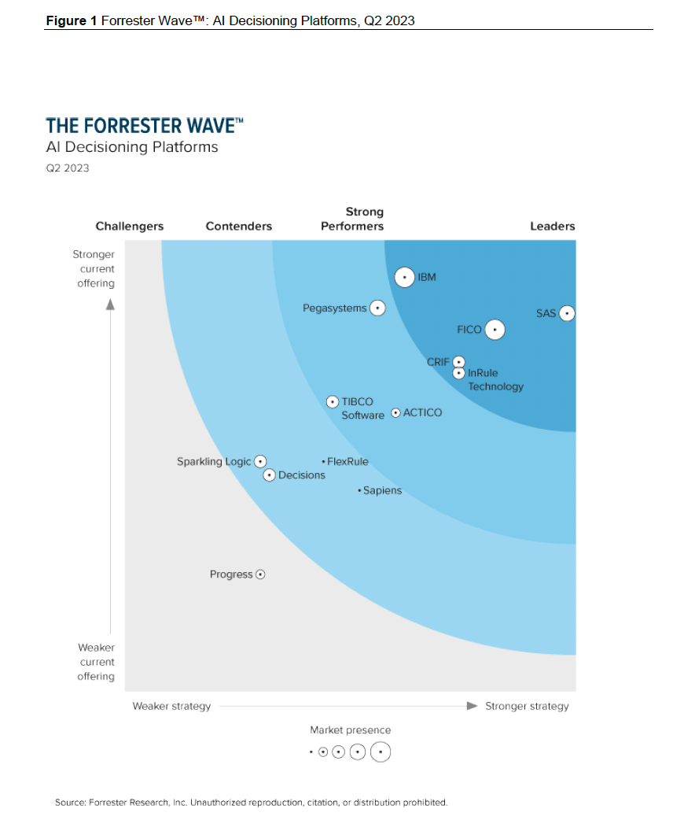
IBM is a leader in The Forrester Wave™: AI Decisioning Platforms, Q2 2023
Highest score in the Current offering category
Highest possible score in authoring
Highest possible score in applications
Highest possible score in supporting products and services
Highest market presence score among all evaluated vendors.
The Forrester Wave™ is copyrighted by Forrester Research, Inc. Forrester and Forrester Wave™ are trademarks of Forrester Research, Inc. The Forrester Wave™ is a graphical representation of Forrester’s call on a market and is plotted using a detailed spreadsheet with exposed scores, weightings, and comments. Forrester does not endorse any vendor, product, or service depicted in the Forrester Wave™. Information is based on best available resources. Opinions reflect judgment at the time and are subject to change.
21
Notes:
As mentioned earlier, we have been and continue to be the global leader for Decisions Management as recognized by Forrester and other top analysts. We have a hardened product with decades of experience from IBM services and our vast business partner community.
In q2 23 we were recognized as a leader in the Forrester Wave™: AI Decisioning Platforms, Q2 2023
This report outlines the combination of traditional decision automation tools with machine learning models and other technologies. As Forrester notes in the report, many organizations are eager to harness the power of AI but also must be cautious of risks. “What these enterprises need,” the report states, “is a platform that can simultaneously enable them to harness the power of AI while enhancing and governing it with well-proven and trusted human business expertise.”
Change made by Forrester

